Slide 1
Инфраструктурни решения за контейнеризация

Slide 2
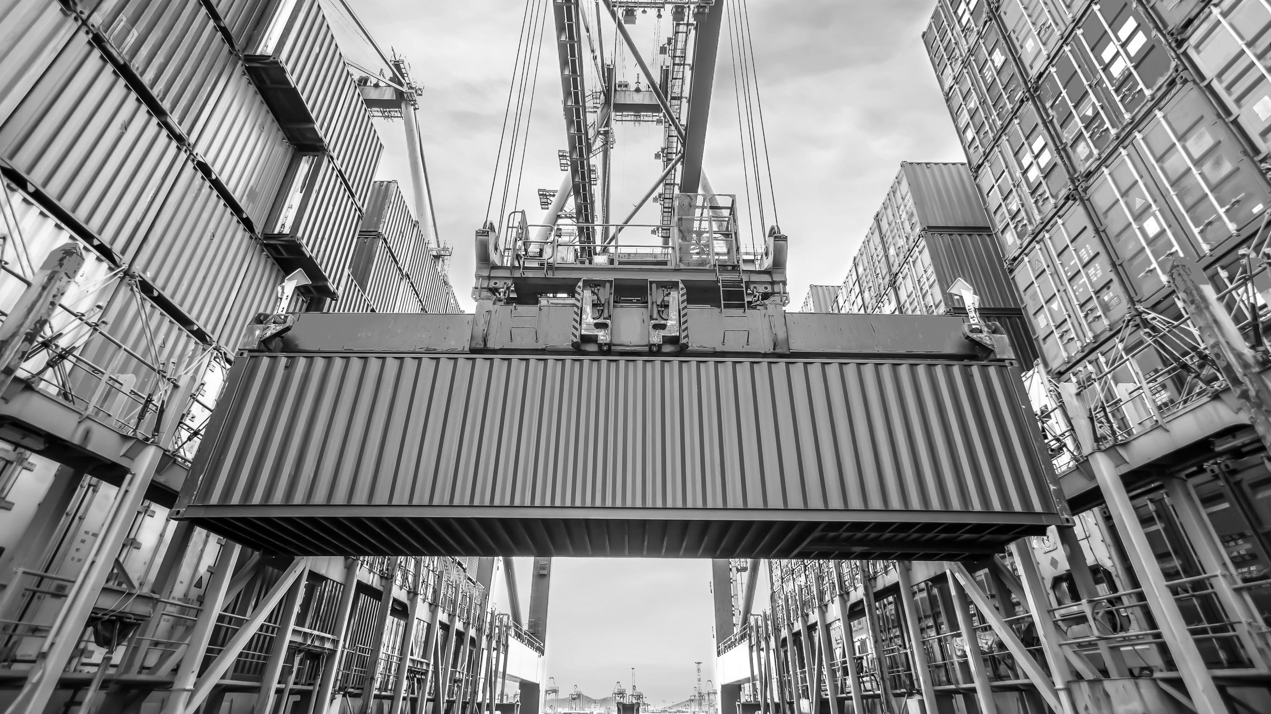
Docker Network

Slide 3
Docker Network
CNM - Container Network Model
CNM Drive extend the model with network topologies.
The CNM has interfaces for IPAM plugins and network plugins.
The open-source Docker library Libnetwork implements all CNM concepts.
Bridge, Host, None, Overlay, and Macvlan are the main 5 network drivers.

Slide 4
Container Network Model Objects
Controller: This component provides an entry point into Libnetwork by exposing simple APIs for Docker Engine to allocate and manage networks.Because Libnetwork supports multiple inbuilt and remote drivers, Network Controller allows users to associate a specific driver with a specific network.
Driver: owns the network and is responsible for managing the network by having multiple drivers participate to satisfy various use cases and deployment scenarios.
Network: Provides connectivity between a group of endpoints that belong to the same network and isolates them from the rest. So, whenever a network is created or updated, the corresponding driver will be notified of the event.
Endpoint: Provides the connectivity of services exposed by a container in a network with other services provided by other containers in the network. An endpoint represents a service and not necessarily a particular container. Endpoints have a global scope within a cluster as well.
Sandbox: Created when users request to create an endpoint on a network. A Sandbox can have multiple endpoints attached to different networks, representing the container’s network configuration such as IP address, MAC address, routes, and DNS.

Slide 5
Container Network Model Objects
Network Sandbox
Network Sandbox
Network Sandbox
Container
Container
Container
Endpoint
Endpoint
Endpoint
Endpoint
Network A
Network B

Slide 6
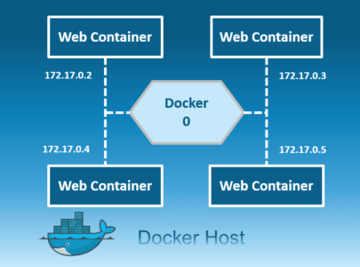
Bridge - Network Driver
Docker's host creates a private default internal network known as the bridge network. All containers get an internal IP address and can communicate using it. Bridge networks are typically used when applications in standalone containers need to communicate.

Slide 7
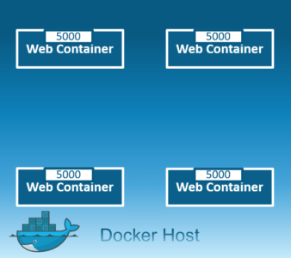
Host - Network Driver
This driver allows containers to use the host's networking without network isolation. Since the port is shared by all host network containers, you cannot run multiple web containers on the same host on the same port.

Slide 8
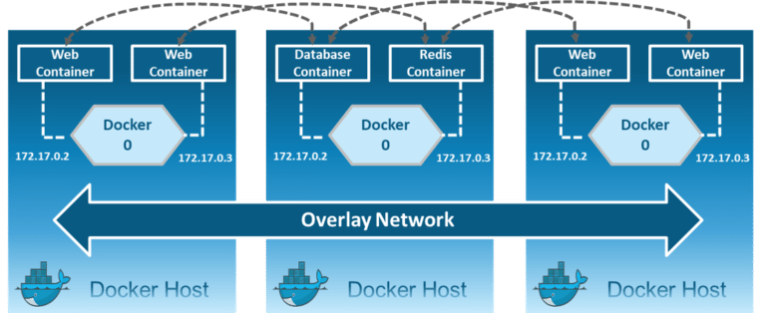
Overlay - Network Driver
Creates an internal private network that spans all nodes within the swarm cluster. Overlay networks therefore enable communication between a swarm service and a standalone container, or between two standalone containers running on separate Docker Daemons.

Slide 9
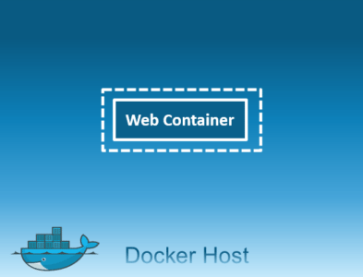
None - Network Driver
In this type of network, containers do not have access to the external network or to other containers. Therefore, this network is used when disabling the networking stack on a container and creating only a loopback device.

Slide 10
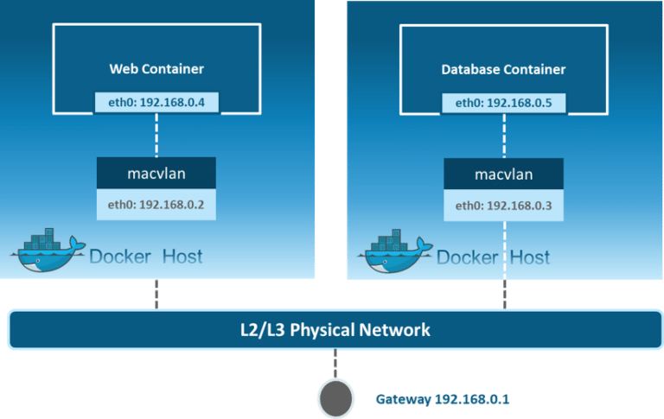
MacVlan - Network Driver
Enables the assignment of a MAC address to a container, making it appear as a physical network device. The Docker daemon then directs traffic to containers according to their MAC addresses. When you expect to be directly connected to the physical network, rather than routed through the Docker host's network stack, the Macvlan driver is the best option.

Slide 11
Network Commands
List networks: docker network ls
Getting detailed info on a network: docker network inspect [NETWORK NAME]
Create network: docker network create [NETWORK NAME]
Removing a network: docker network rm [NETWORK NAME]
Remove all unused networks: docker network prune
Adding a container to a network: docker network connect [NETWORK NAME] [CONTAINER ID/NAME]

Slide 12
Network Commands
Removing a container from a network: docker network disconnect [NETWORK NAME] [CONTAINER ID/NAME]
Create a network with Subnet and Gateway: docker network create --subnet [SUBNET] --gateway [GATEWAY] \ [NETWORK NAME] docker network create --subnet --gateway [GATEWAY] \ --ip-range=[IP_RANGE] --driver==[DRIVER]

Slide 13
DEMO
Lists all the available networks on the Docker host. docker network ls
Provide detailed information about the "bridge" and "host" networks, respectively. docker network inspect bridge docker network inspect host
Create a new network named "bridge-1“. docker network create bridge-1
Run a new Docker container named "web-bridge" using the nginx image. docker container run -d --name web-bridge -p 80:80 nginx
Connects the "web-bridge" container to the "bridge-n-1" network. docker network connect bridge-n-1 web-bridge
Inspects the details of the "web-bridge" container network drivers. docker container inspect web-bridge
Disconnects the container from the "bridge-n-1" network. docker network disconnect bridge-n-1 web-bridge
removes the "bridge-1" network. docker network rm “bridge-1”

Slide 14
Demo 2
Create a new Docker network named bridge-n-2 with a specified subnet range, gateway, IP range, and network driver. docker network create --subnet 10.5.0.0/16 --gateway 10.5.0.1 --ip-range=10.5.20.0/24 --driver=bridge bridge-n-2
Inspects the properties of the bridge-n-2 network. docker network inspect bridge-n-2
Run a new container named n-tester-1 using the debian image and attaches it to the bridge-n-2 network. docker container run --name n-tester-1 -it --network bridge-n-2 debian /bin/bash
Updates the package list in the container and install the net-tools package apt-get update –y apt-get install net-tools
Display network information about the container (ifconfig, netstat, and /etc/resolv.conf ifconfig netstat –rn cat /etc/resolv.conf
exit

Slide 15
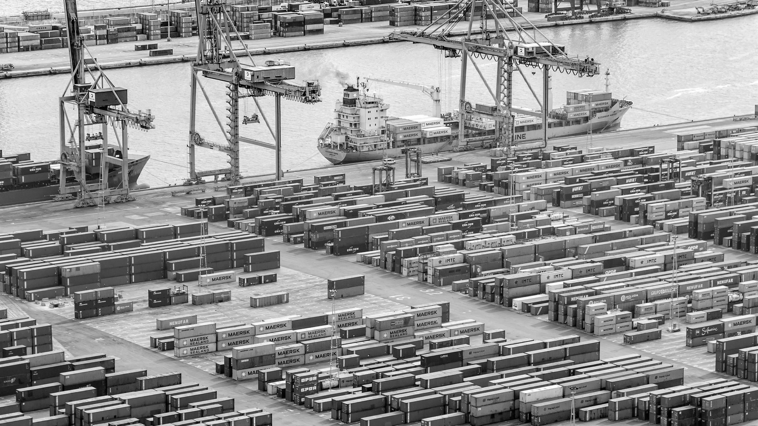
Thank You!

